Slide 1
Chapter 8: Simple Linear Regression
Part 3

Slide 2
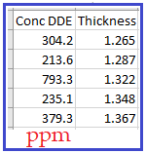
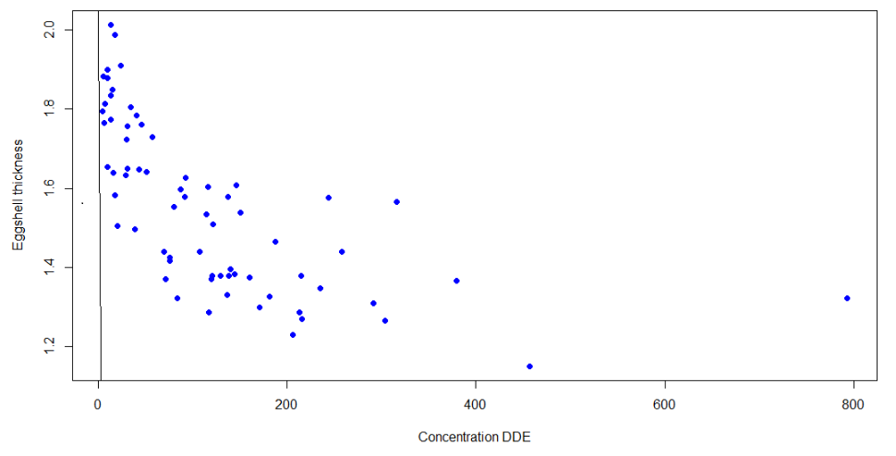
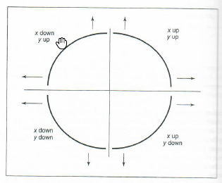
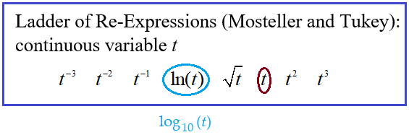
Return to Peregrine Falcon Data

Slide 3


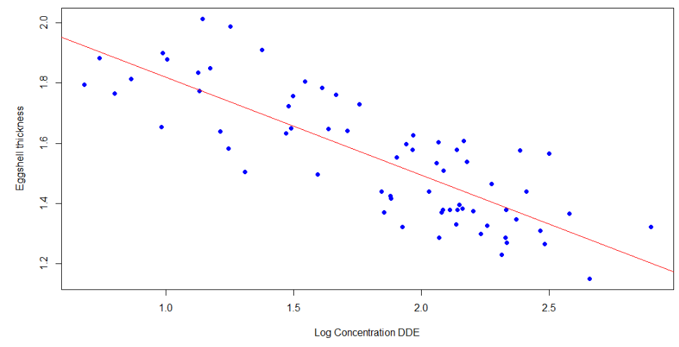
Apply log transformation to concentration

Slide 4
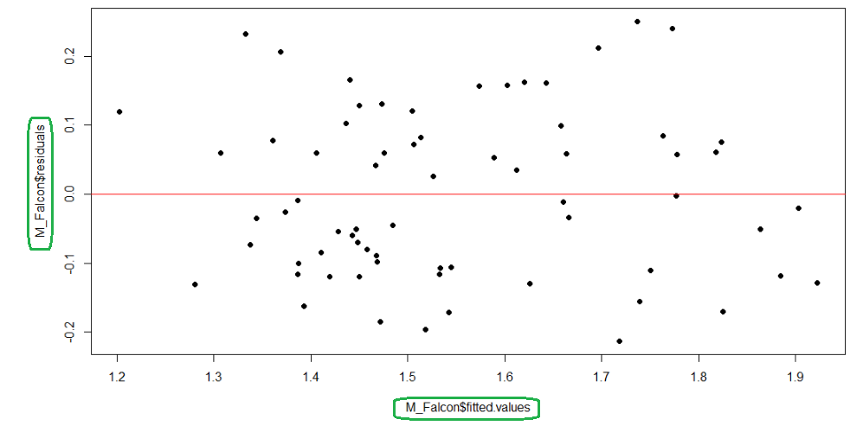
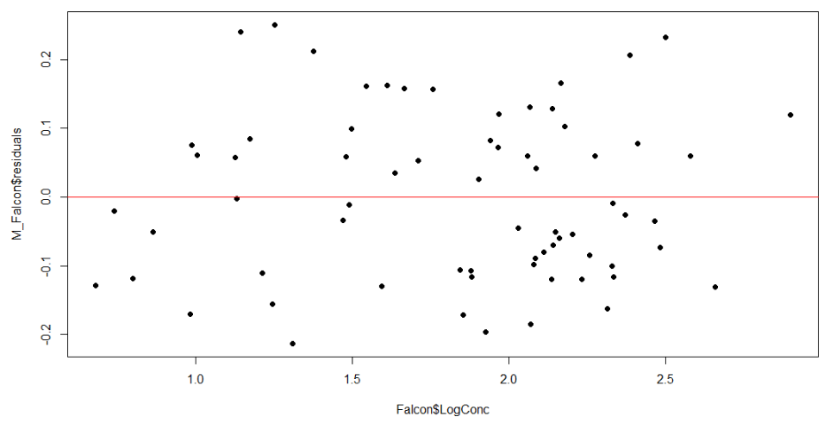
Residual Plot

Slide 5
Inference for Regression
https://www.learner.org/series/against-all-odds-inside-statistics/
Against All Odds: Inside Statistics
Unit 30: Inference for Regression
Population Model:
Assumptions?

Slide 6
Conditions for Regression Inference 1
The slope and intercept of the least-squares line are statistics. That is, we calculate them from the sample data. These statistics would take somewhat different values if we repeated the data production process. To do inference, think of b₀ and b₁ as estimates of unknown parameters β₀ and β₁ that describe the population of interest.
Conditions for Regression Inference
We have n observations on an explanatory variable x and a response variable y. Our goal is to study or predict the behavior of y for given values of x.
For any fixed value of x, the response y varies according to a Normal distribution. Repeated responses y are independent of each other.
The mean response µ_{y} has a straight-line relationship with x given by a population regression line µ_{y}= β₀ + β₁x.
The slope and intercept are unknown parameters.
The standard deviation of y (call it σ) is the same for all values of x. The value of σ is unknown.

Slide 7
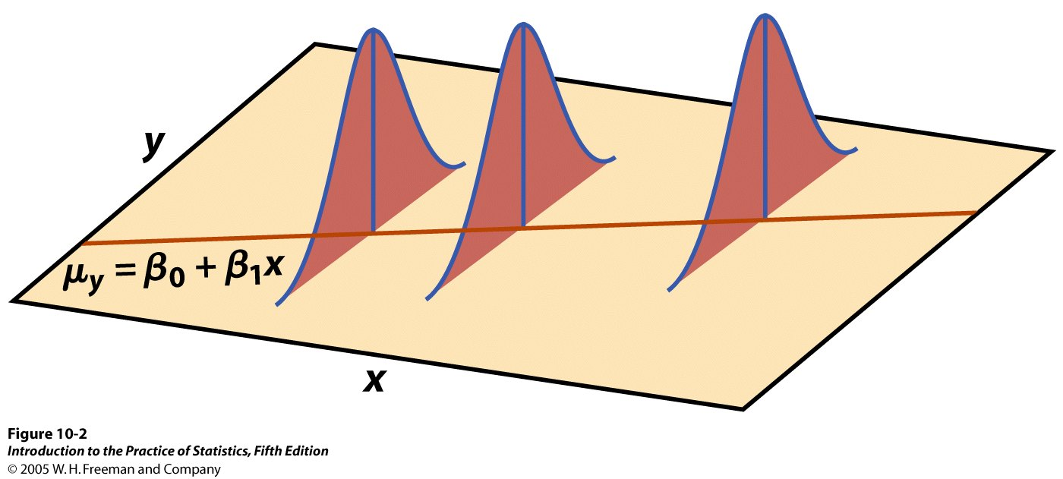
Conditions for Regression Inference 2
The figure below shows the regression model when the conditions are met. The line in the figure is the population regression line µ_{y}= β₀ + β₁x.
For each possible value of the explanatory variable x, the mean of the responses µ(y | x) moves along this line.
The Normal curves show how y will vary when x is held fixed at different values. All the curves have the same standard deviation σ, so the variability of y is the same for all values of x.
The value of σ determines whether the points fall close to the population regression line (small σ) or are widely scattered (large σ).

Slide 8
Simple Linear Regression Model
In the population, the linear regression equation is μ_{y} = β₀ + β₁x.
Sample data fits the simple linear regression model:
Data = Fit + Error
y_{i} = (β₀ + β₁x_{i}) + (ε_{i})
where the ε_{i} are independent and Normally distributed N(0,σ).
Linear regression assumes equal variance of y (σ is the same for all values of x).

Slide 9
Checking the Conditions for Regression Inference
You can fit a least-squares line to any set of explanatory-response data when both variables are quantitative. If the scatterplot does not show a roughly linear pattern, the fitted line may be almost useless.
Before you can trust the results of inference, you must check the conditions for inference one by one.
The relationship is linear in the population.
The response varies Normally about the population regression line.
Observations are independent.
The standard deviation of the responses is the same for all values of x.
You can check all of the conditions for regression inference by looking at graphs of the residuals or residual plots.

Slide 10
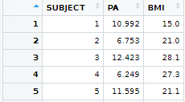
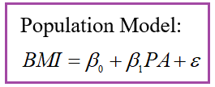



Relationship between BMI and physical activity (sample: 100 undergraduate students, PABMI)

Slide 11
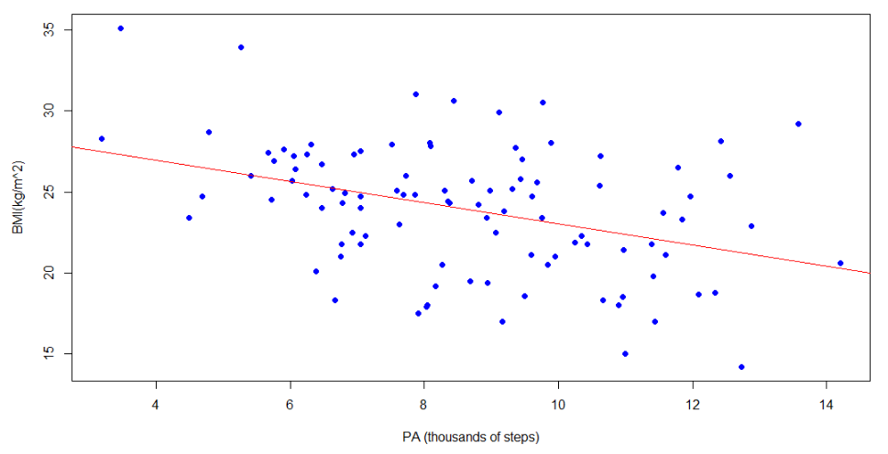
Scatterplot with graph of least-squares regression line

Slide 12

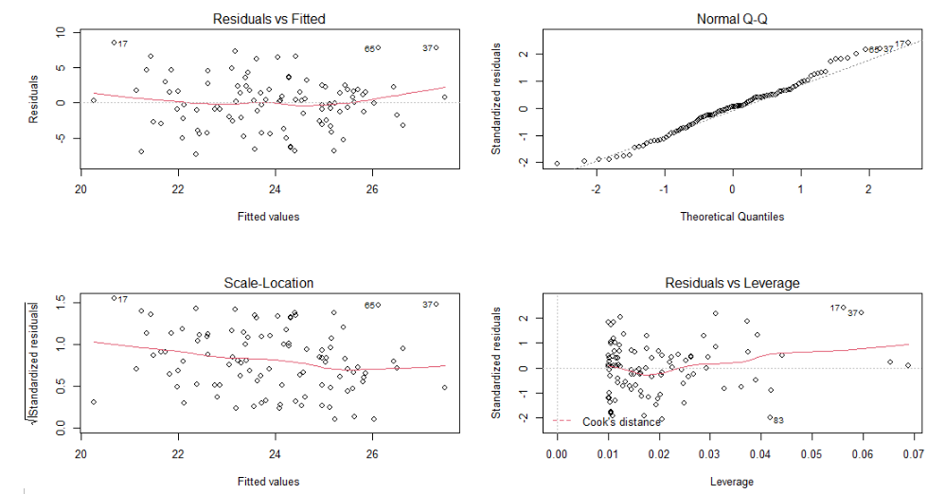



Plot(M_PABMI)

Slide 13
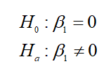
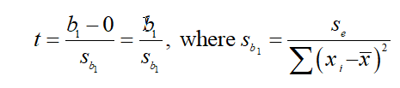

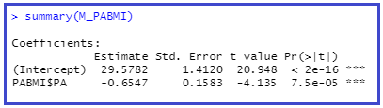

Significance Test for Population Model Slope

Slide 14
Confidence Interval for Slope
The slope β₁ of the population regression line µ_{y} = β₀ + β₁x is the rate of change of the mean response as the explanatory variable increases. We often want to estimate β₁. The slope b₁ of the sample regression line is our point estimate for β₁.
The confidence interval for β₁ has the familiar form:
Estimate ± t* · (standard error of estimate)
Because we use the statistic b₁ as our estimate, the confidence interval is:
b₁ ± t* S_{b1}
Confidence Interval for Regression Slope
A level C confidence interval for the slope β₁ of the population regression line is:
b₁ ± t* S_{b1}
Here t* is the critical value for the t distribution with df = n – 2 having area C between –t* and t*.

Slide 15

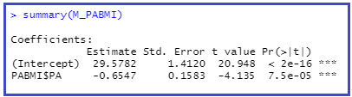



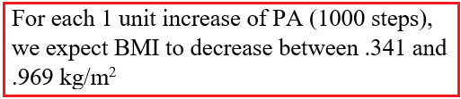
Confidence Interval for Slope

Slide 16

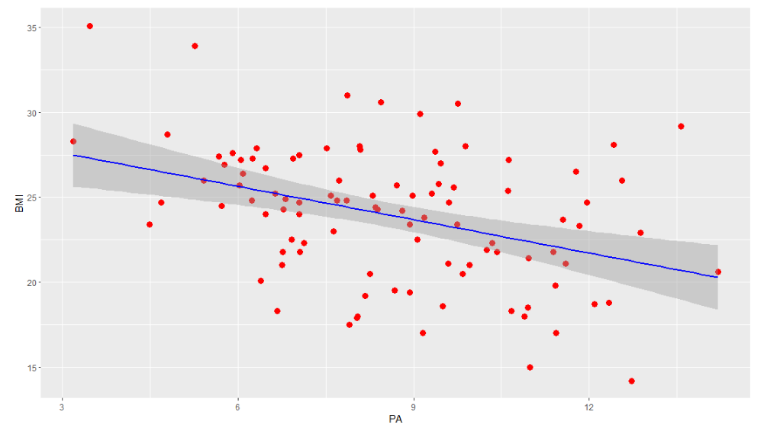



Slide 17
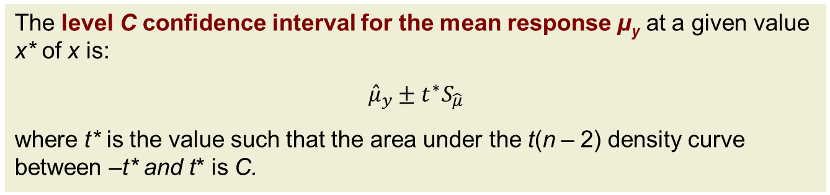
Confidence Interval for Mean Response
We can also calculate a confidence interval for the population mean μ_{y} of all responses y when x takes the value x* (within the range of data tested).
The level C confidence interval for the mean response μ_{y} at a given value x* of x is:
$${\hat{μ}}_{y}±t^{∗}S_{\hat{μ}}$$
where t* is the value such that the area under the t(n – 2) density curve between –t* and t* is C.
A separate confidence interval could be calculated for μ_{y} along all the values that x takes.
Graphically, the series of confidence intervals is shown as a continuous curve on either side of ŷ.

Slide 18
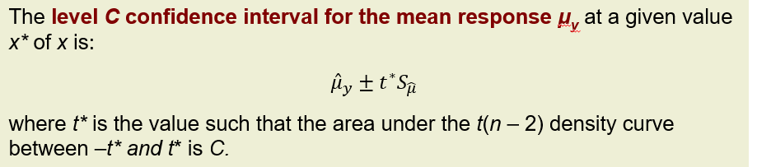
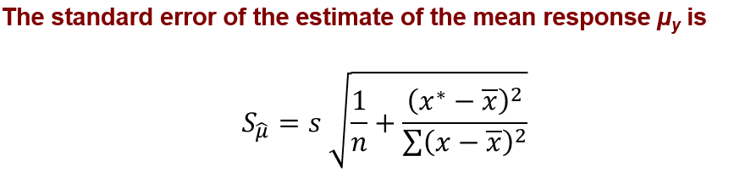

Confidence Interval for Mean Response

Slide 19

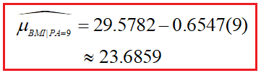
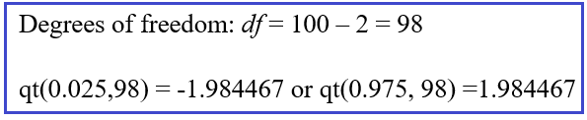
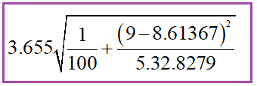
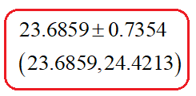
Calculate the confidence interval for the mean response for x = 9

Slide 20
Prediction Intervals 1
One use of regression is for predicting the value of y at some value of x within the range of data tested. Reliable predictions require statistical inference.
To estimate an individual response y for a given value of x, we use a prediction interval.
If we randomly sampled many times, there would be many different values of y obtained for a particular x following N(0, σ) around the mean response µ_{y}.

Slide 21
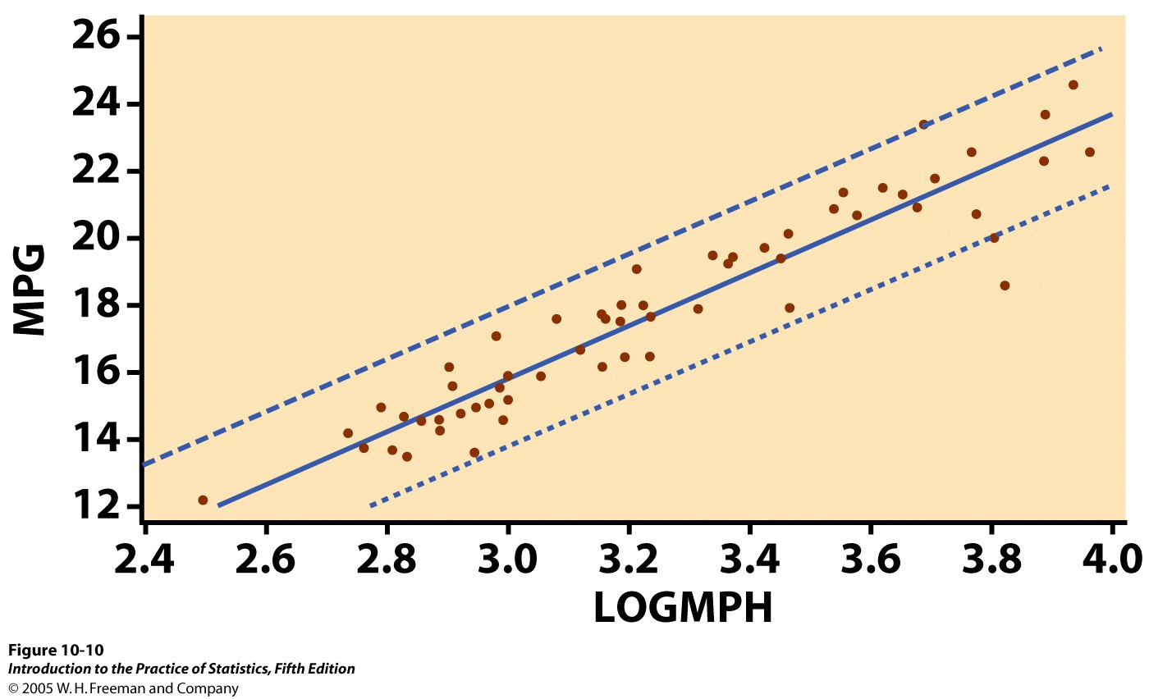
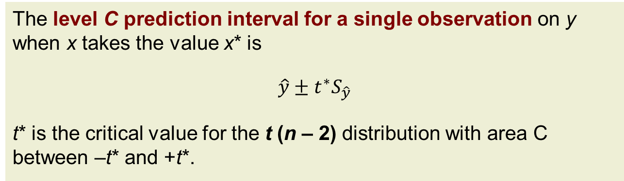
Prediction Intervals 2
The level C prediction interval for a single observation on y when x takes the value x* is
$$\hat{y}±t^{∗}S_{\hat{y}}$$
t* is the critical value for the t (n – 2) distribution with area C between –t* and +t*.
The prediction interval accounts for error in estimating β₀ and β₁ as well as uncertainty about the value of y being predicted.
Graphically, the series of prediction intervals is shown as a continuous curve on either side of ŷ. These prediction intervals are wider than the corresponding confidence intervals for μ_{y} .

Slide 22
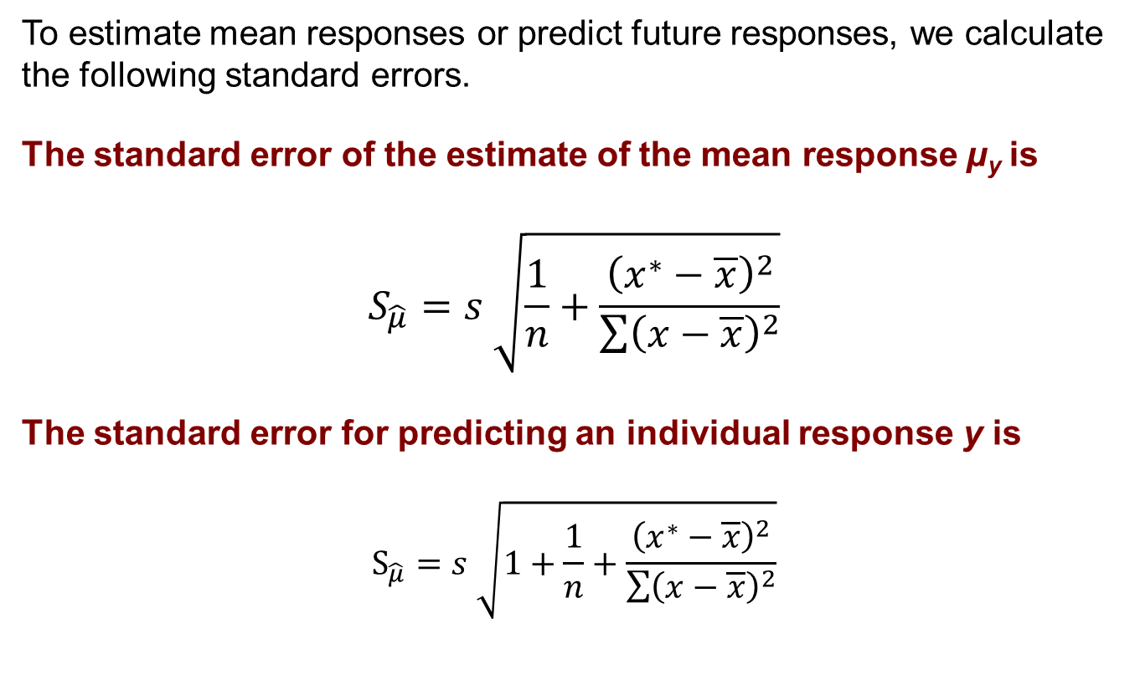
Calculations for Regression Inference 2
To estimate mean responses or predict future responses, we calculate the following standard errors.
The standard error of the estimate of the mean response µ_{y} is
$$S_{\hat{μ}}=s \sqrt{\frac{1}{n}+\frac{{\left(x^{∗}−\overline{x}\right)}^{2}}{\sum{{\left(x−\overline{x}\right)}^{2}}}}$$
The standard error for predicting an individual response y is $$S_{\hat{μ}}=s \sqrt{1+\frac{1}{n}+\frac{{\left(x^{∗}−\overline{x}\right)}^{2}}{\sum{{\left(x−\overline{x}\right)}^{2}}}}$$

Slide 23
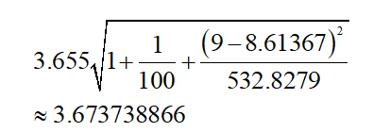


For individual y:

